Slide 1


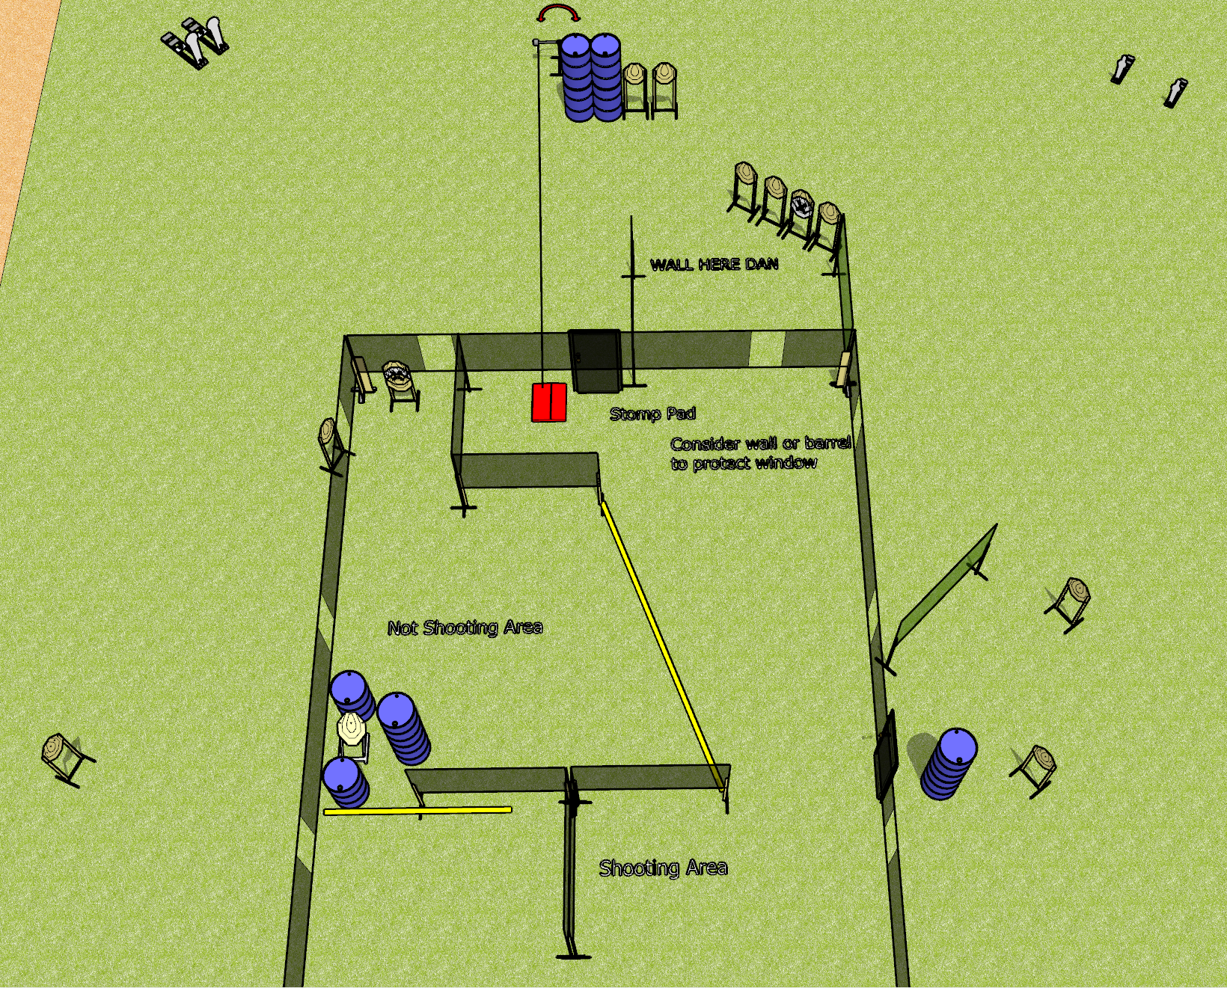
 | Dothan Gun Club – USPSA Match A House Pun Course Designer : Drew Coleman
Round Count 32 rounds 14 IPSC 2 colt poppers, 2 mini poppers
Equipment List 6 wall feet Swinger + stomp box 16 targets (14 + 2NS)

Slide 2
A House Pun
Written Stage Briefing
A House Pun is a 32 round, 160 point, Comstock course of fire. There are 14 IPSC targets, 2 colt poppers, and 2 mini poppers. The best 2 hits on paper will score, and steel must fall to score. The start signal is audible.
The swinger is activated by the stomp box and remains visible at rest.
Handgun start position is inside the shooting area, wrists below belt. Handgun is loaded and holstered.
PCC start position is inside the shooting area, stock on belt. Loaded carbine is held with both hands, safety on.
On start signal, engage targets from as they become available from within the shooting area.
All doors must be closed prior to the start signal.

